Slide 1
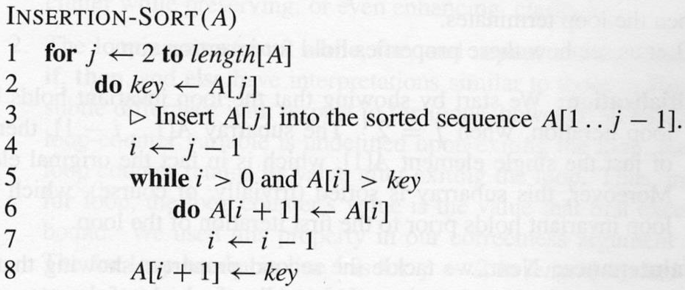
position | 1 | 2 | 3 | 4 | 5 | 6 | A
value | 2 | 8 | 4 | 9 | 3 | 6
Line 1 : j=2
Line 2: key = A[j] , key = A[2] , key= 2
Line 4: i= j-1, i= 2-1, i=1
Line 5: while (i>0 and A[i] >key) while ( 1>0 and 8>2) – true – line 6,7
Line 6: A[i+1] = A[i], A[2]=A[1], A[2]=8
Line 7: i=i-1 , i= 1-1 = 0
Line 5: while (i>0 and A[i] >key) while ( 0>0 and A[0] >key) (false) → line 8
Line 8 : A[i+1]= key, A[0+1]=key, A[1]=2

Slide 2
index | 1 | 2 | 3 | 4 | 5 | 6 | A
value | 2 | 4 | 8 | 9 | 3 | 6
Line 1: j=3
Line 2: key=A[j], key=A[3], key=4
Line 4: i=j-1 , i=3-1=2
Line 5: while (2>0 and A[2] > key) while (2>0 and 8>4) true – line 6,7
Line 6: A[i+1]=A[i], A[3]=A[2], A[3]=8
Line 7: i=i-1, i=2-1=1
Line 5: while (i>0 and A[i] > key) while (1>0 and A[1]>key) while (1>0 and 2>4) false , line 8
Line 8: A[i+1]=key, A[1+1]=key, A[2]=4

Slide 4
Insertion Sort Complexity Analysis

Slide 5
for(j=1;j<n;j++){
key=a[j];
i=j-1;
while(i>=0 && a[i]< key){
a[i+1] = a[i];
i--;
}
a[i+1]=key;
}

Slide 6
for(j=1;j<n;j++){ | For loop (n-1) j<n Key=a[j] i=j-1 while loop (n-1) i>=0 && a[i]< key a[i+1] = a[i] i-- a[i+1]=key j++ Extra : j=1
key=a[j];
i=j-1;
while(i>=0 && a[i]< key){
a[i+1] = a[i];
i--;
}
a[i+1]=key;
}

Slide 7
for(j=1;j<n;j++){ | For loop (n-1) j<n Key=a[j] i=j-1 while loop (n-1) i>=0 && a[i]< key a[i+1] = a[i] i-- a[i+1]=key j++ Extra : j=1
key=a[j];
i=j-1;
while(i>=0 && a[i]< key){
a[i+1] = a[i];
i--;
}
a[i+1]=key;
}
c1

Slide 8
for(j=1;j<n;j++){ | For loop (n-1) j<n Key=a[j] i=j-1 while loop (n-1) i>=0 && a[i]< key a[i+1] = a[i] i-- a[i+1]=key j++ Extra : j=1
key=a[j];
i=j-1;
while(i>=0 && a[i]< key){
a[i+1] = a[i];
i--;
}
a[i+1]=key;
}
c1
c2

Slide 9
for(j=1;j<n;j++){ | For loop (n-1) j<n Key=a[j] i=j-1 while loop (n-1) i>=0 && a[i]< key a[i+1] = a[i] i-- a[i+1]=key j++ Extra : j=1
key=a[j];
i=j-1;
while(i>=0 && a[i]< key){
a[i+1] = a[i];
i--;
}
a[i+1]=key;
}
c1
c2
c3

Slide 10
for(j=1;j<n;j++){ | For loop (n-1) j<n Key=a[j] i=j-1 while loop (n-1) i>=0 && a[i]< key a[i+1] = a[i] i-- a[i+1]=key j++ Extra : j=1
key=a[j];
i=j-1;
while(i>=0 && a[i]< key){
a[i+1] = a[i];
i--;
}
a[i+1]=key;
}

Slide 11
for(j=1;j<n;j++){ | For loop (n-1) j<n Key=a[j] i=j-1 while loop (n-1) i>=0 && a[i]< key a[i+1] = a[i] i-- a[i+1]=key j++ Extra : j=1
key=a[j];
i=j-1;
while(i>=0 && a[i]< key){
a[i+1] = a[i];
i--;
}
a[i+1]=key;
}
Number of machine instructions: (n-1)*{ c1 + (n-1)*c2 }+ c3

Slide 12
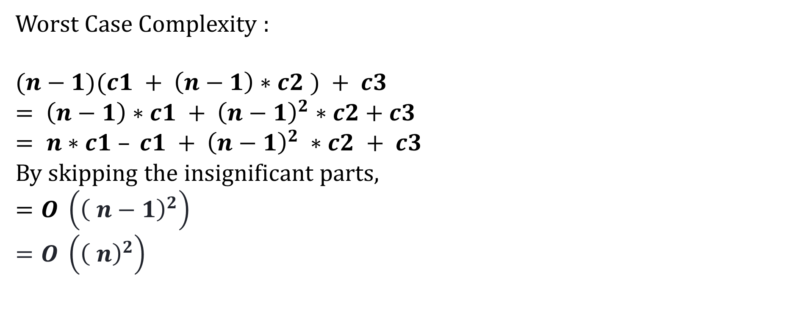
Worst Case Complexity :
$$(n−1)(c1 + \left(n−1\right)∗c2 ) + c3$$
$$= \left(n−1\right)∗c1 + {\left(n−1\right)}^{2}∗c2+c3$$
$$= n∗c1 – c1 + {\left(n−1\right)}^{2} ∗c2 + c3$$
By skipping the insignificant parts,
$$=O \left({\left( n−1\right)}^{2}\right)$$
$$=O \left({\left( n\right)}^{2}\right)$$

Slide 13
for(j=1;j<n;j++){ | For loop (n-1) j<n Key=a[j] i=j-1 while loop (1) i>=0 && a[i]< key a[i+1] = a[i] i-- a[i+1]=key j++ Extra : j=1
key=a[j];
i=j-1;
while(i>=0 && a[i]< key){
a[i+1] = a[i];
i--;
}
a[i+1]=key;
}
Number of machine instructions: (n-1)*{ c1 + 1*c2 }+ c3

Slide 14
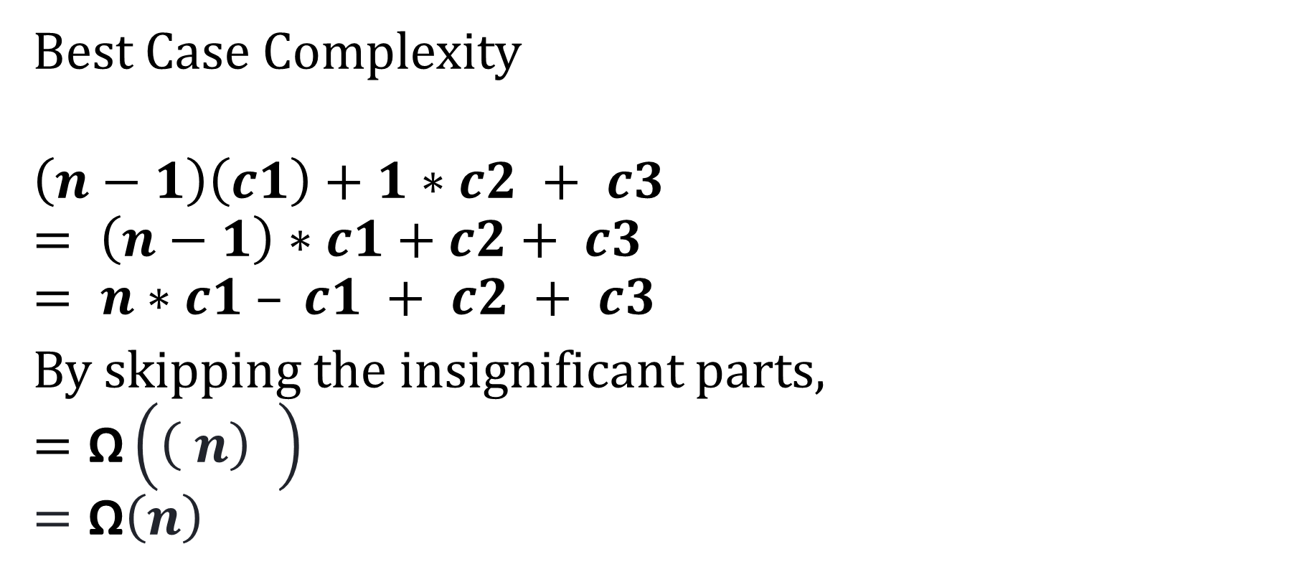
Number of machine instructions: (n-1)*{ c1 + 1*c2 }+ c3
Best Case Complexity
$$\left(n−1\right)\left(c1\right)+1∗c2 + c3$$
$$= \left(n−1\right)∗c1+c2+ c3$$
$$= n∗c1 – c1 + c2 + c3$$
By skipping the insignificant parts,
$$=\text{Ω}\left({\left( n\right)}^{6}\right)$$
$$=\text{Ω}\left(n\right)$$

Slide 15

$Average Case$ Complexity
Average number of iterations in $while loop:$
= $\frac{1+2+3+ ………. +(n−1)}{(n−1)}$
= $\frac{\frac{n(n−1)}{2} }{(n−1)}$
= $\frac{n}{2}$

Slide 16
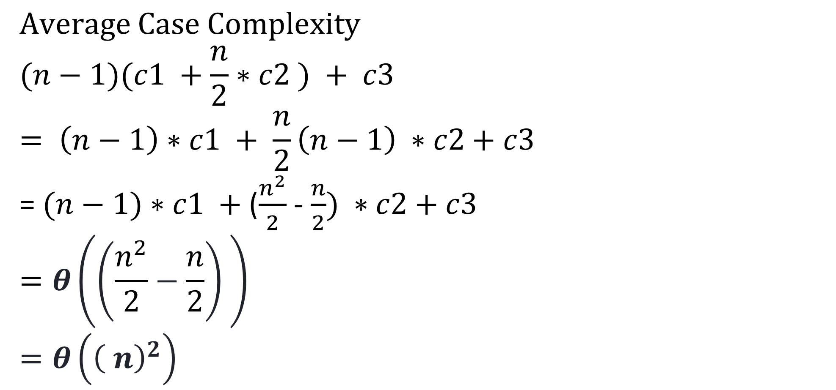
$$Average Case \text{Complexity}$$
$$(n−1)(c1 +\frac{n}{2}∗c2 ) + c3$$
$$= \left(n−1\right)∗c1 + {\frac{n}{2}\left(n−1\right)}^{ }∗c2+c3$$
= $(n−1)∗c1 +$($\frac{n^{2}}{2}$ - $\frac{n}{2}) ∗c2+c3$
$$=θ\left({\left(\frac{n^{2}}{2}−\frac{n}{2}\right)}^{ }\right)$$
$$=θ\left({\left( n\right)}^{2}\right)$$

